Slide 1


rhodeskesi
Cannon simulator!
VGP256 MATH AND PHYSICS FOR GAMES Tijana Sretenovic Jiangyahu Liu - 2312738 2024/9/16

Slide 2
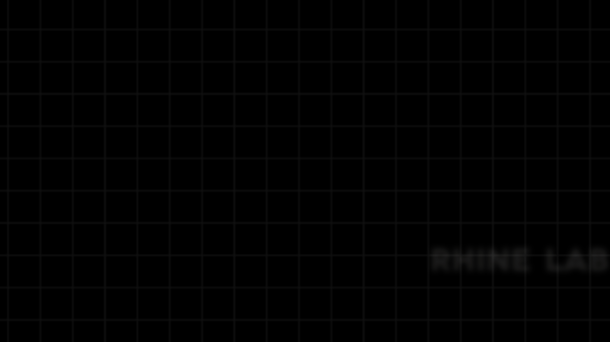

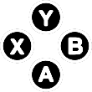
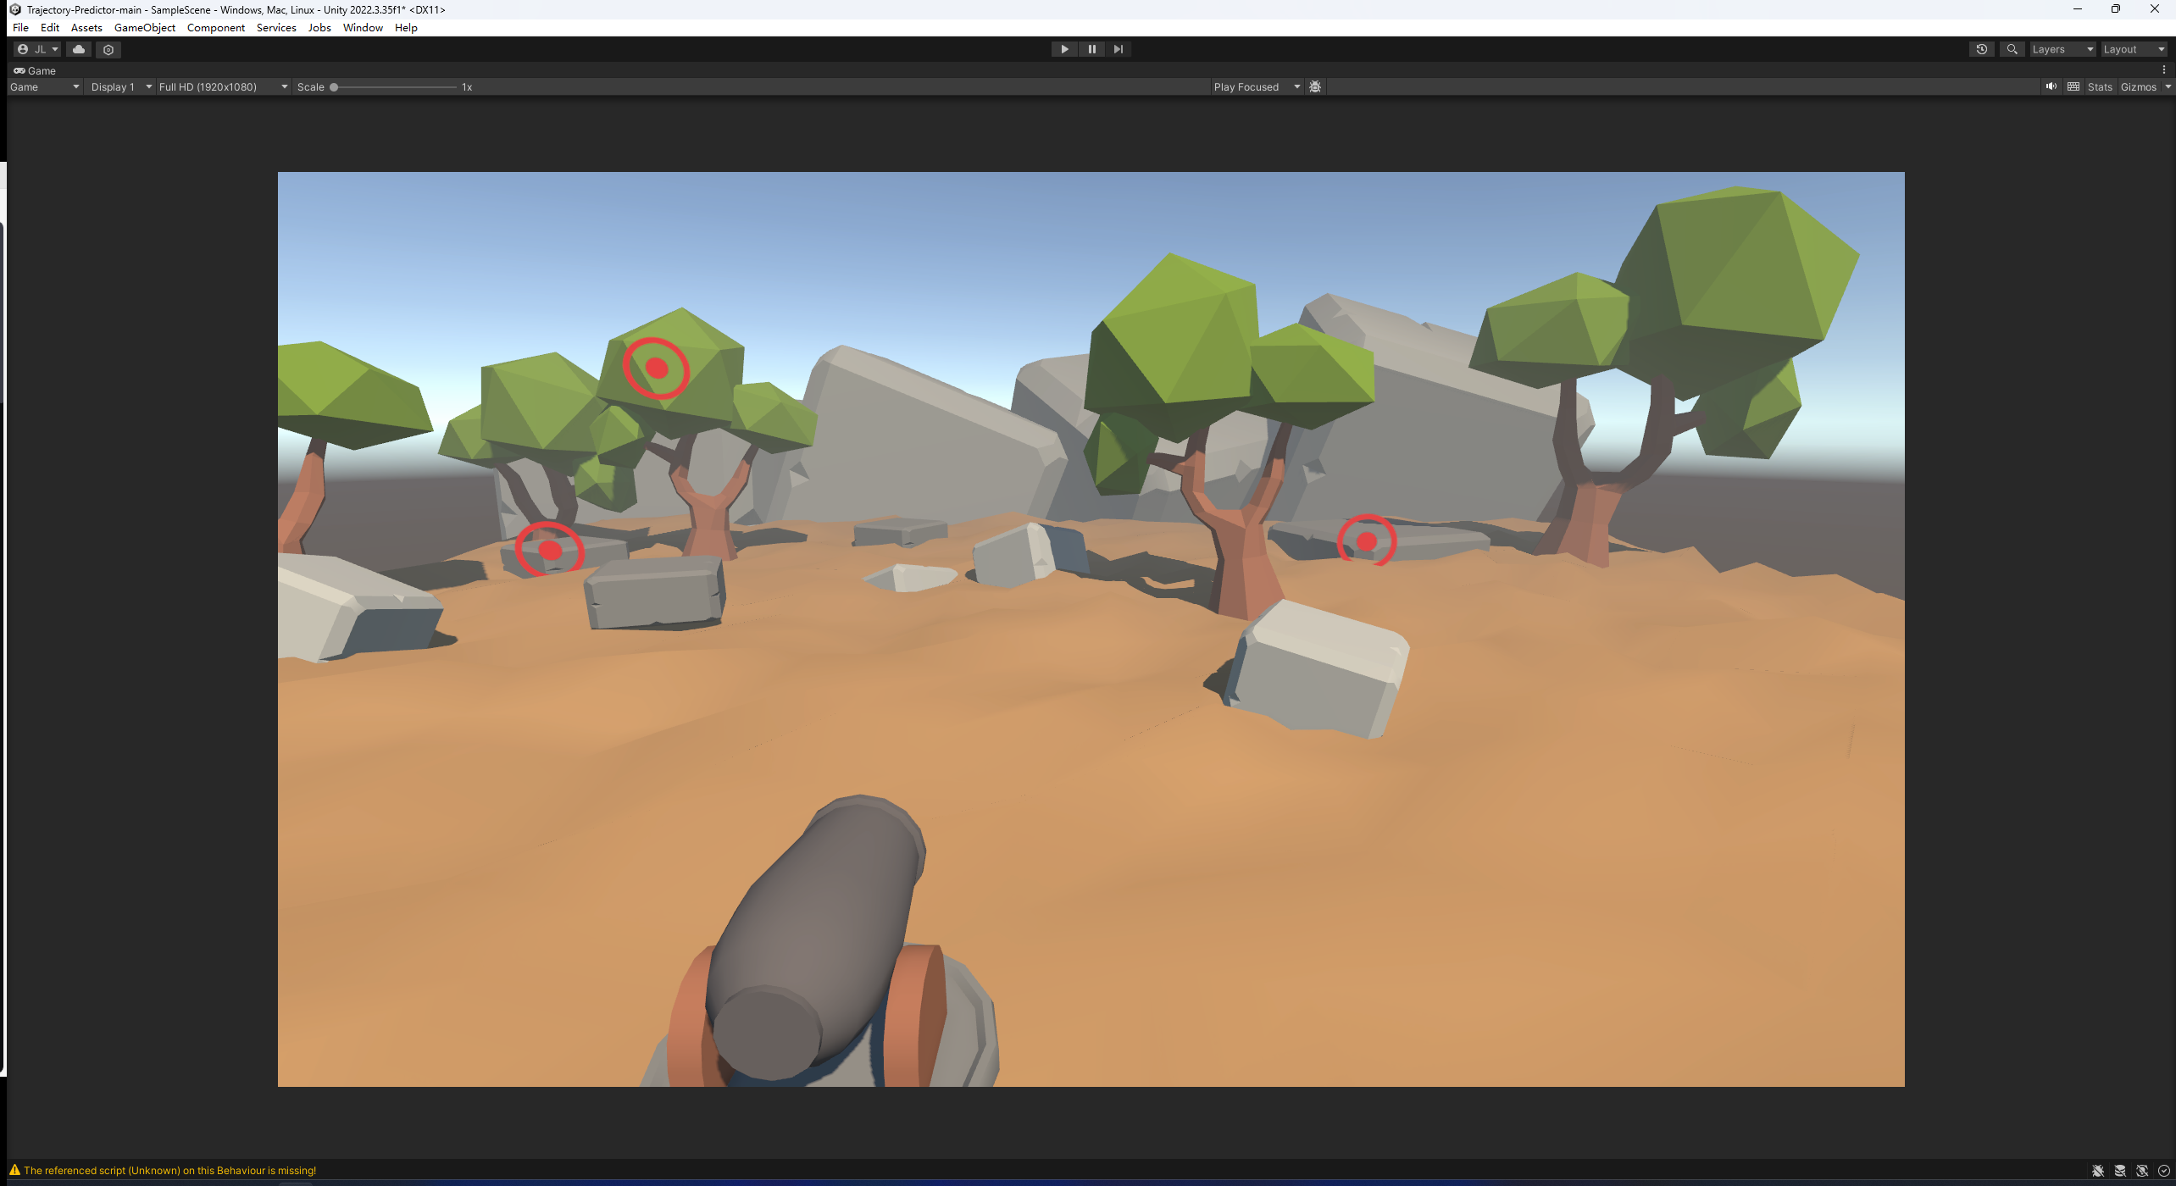
Cannon!!!!
rhodeskesi

Slide 3

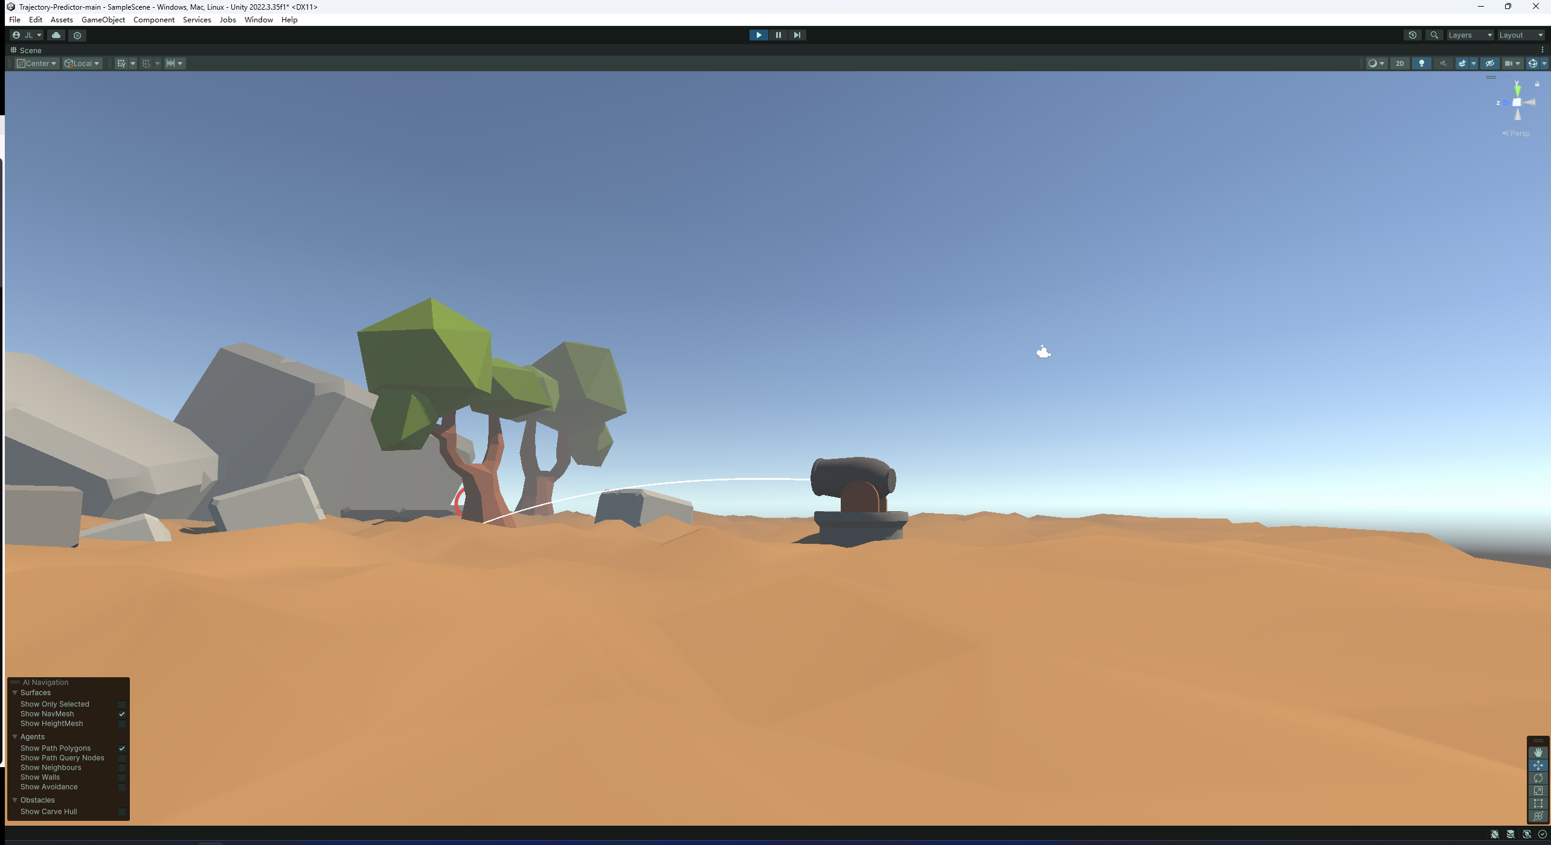
Cannon!!!!
Simulating a Cannon without using Unity's physics
rhodeskesi
The projectile will change movements with gravity and air resistance
A prediction line and drop point location will be displayed

Slide 4
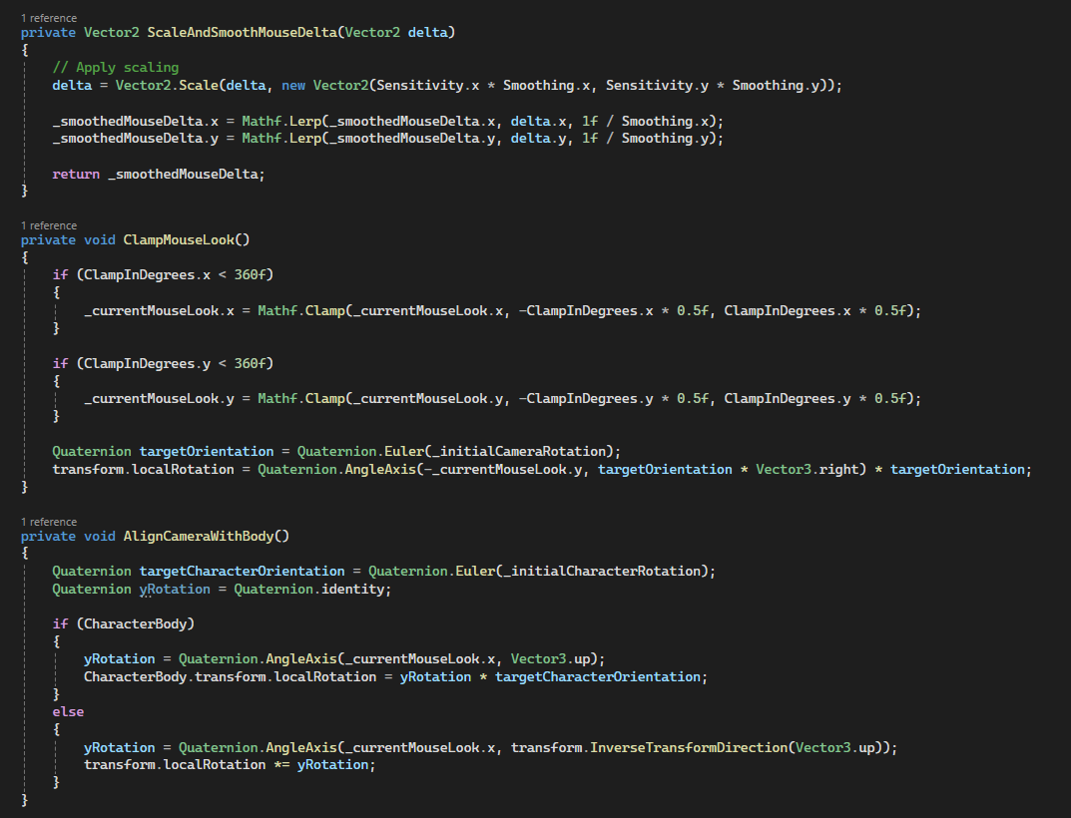
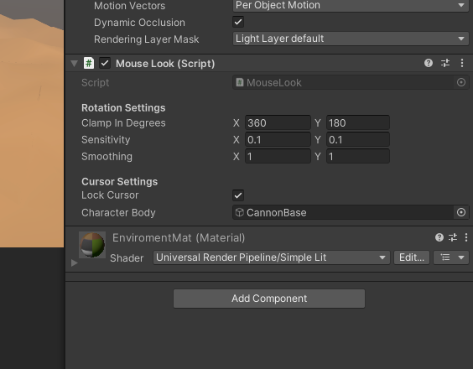
Basic design
rhodeskesi
The cannon will rotate and aim with the mouse

Slide 5
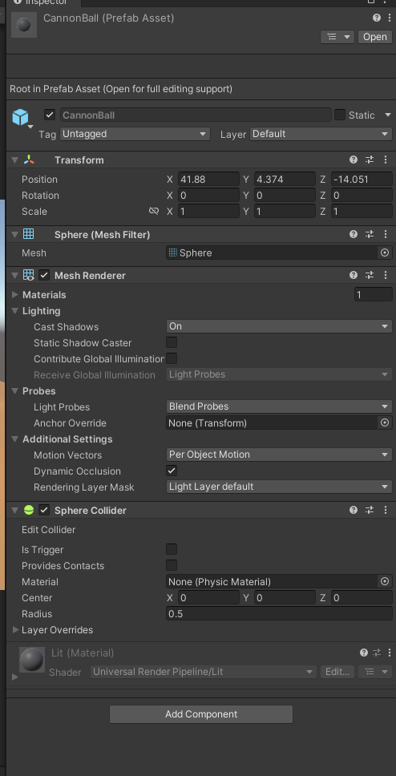
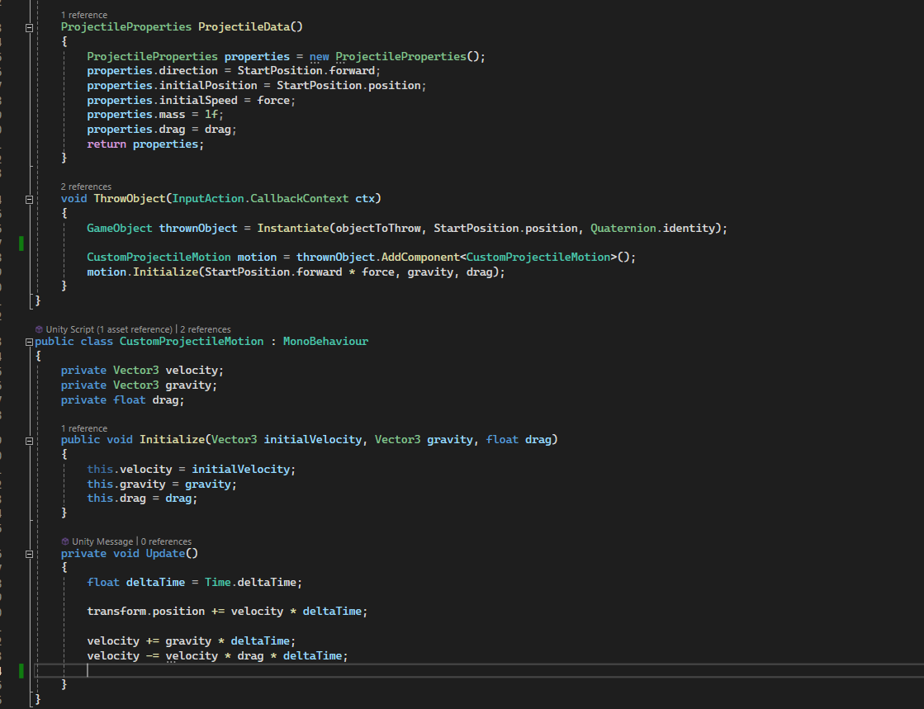
Simulate various data and add movement
Add it to the starting point instead of the Ball. The Ball itself has no attributes.

Slide 6
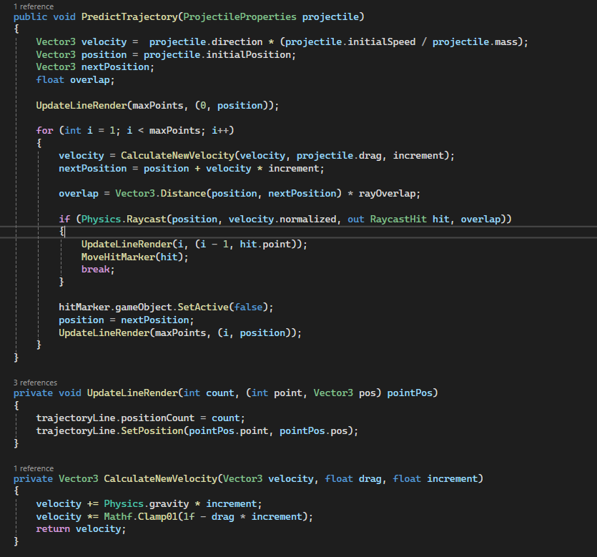
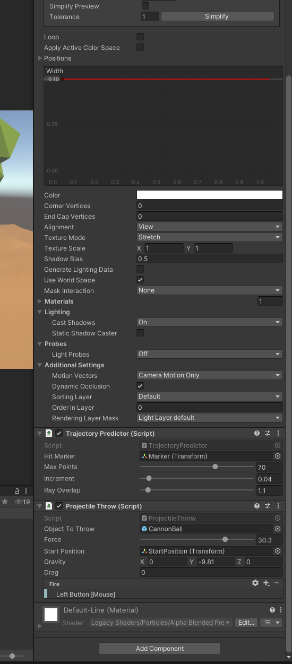
The length of the prediction line can be changed. The prediction line will change according to air resistance and gravity.

Slide 7
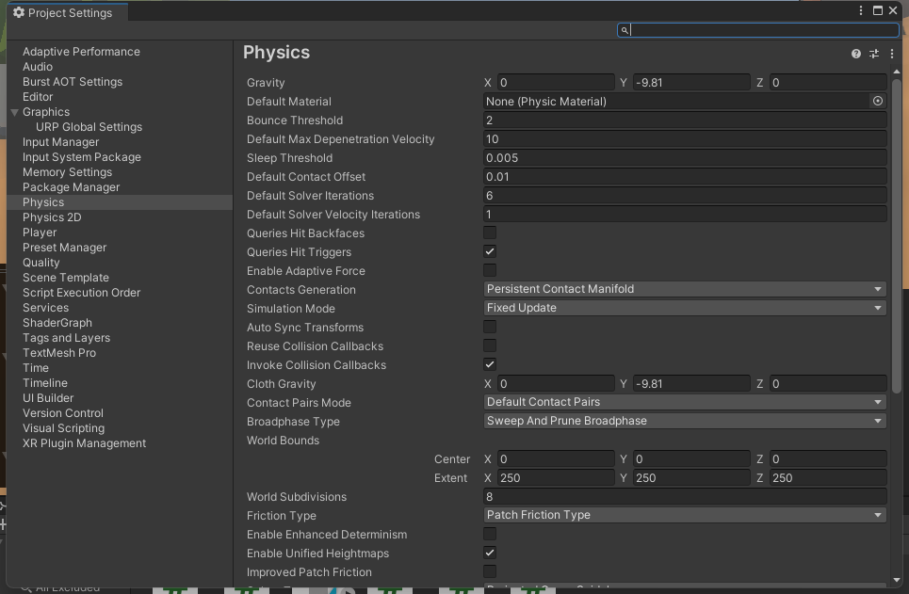
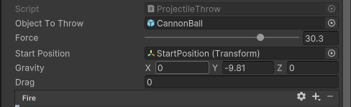
Comparison to the implemented solution
The value of Gravity, mass and velocity of each object are separately adjustable

Slide 8
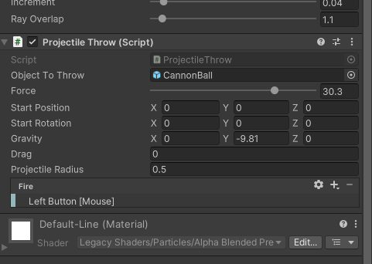
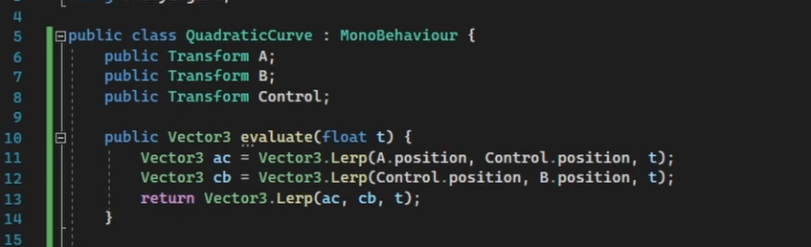
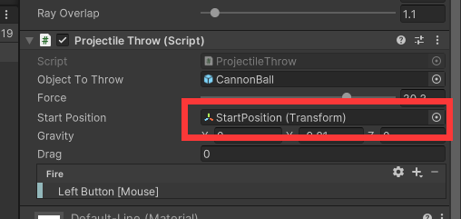
The reason why I still use the Transform information of the initial point is that if you enter it manually, you will not be able to track variables such as rotation

Slide 9



Thanks For Watching
CITY OF SCIENCE AND TECHNOLOGY

